Slide 1
Understanding neurodivergence in the workplace
Understanding neurodivergence in the workplace
Integrated neuro-inclusion services

Slide 2
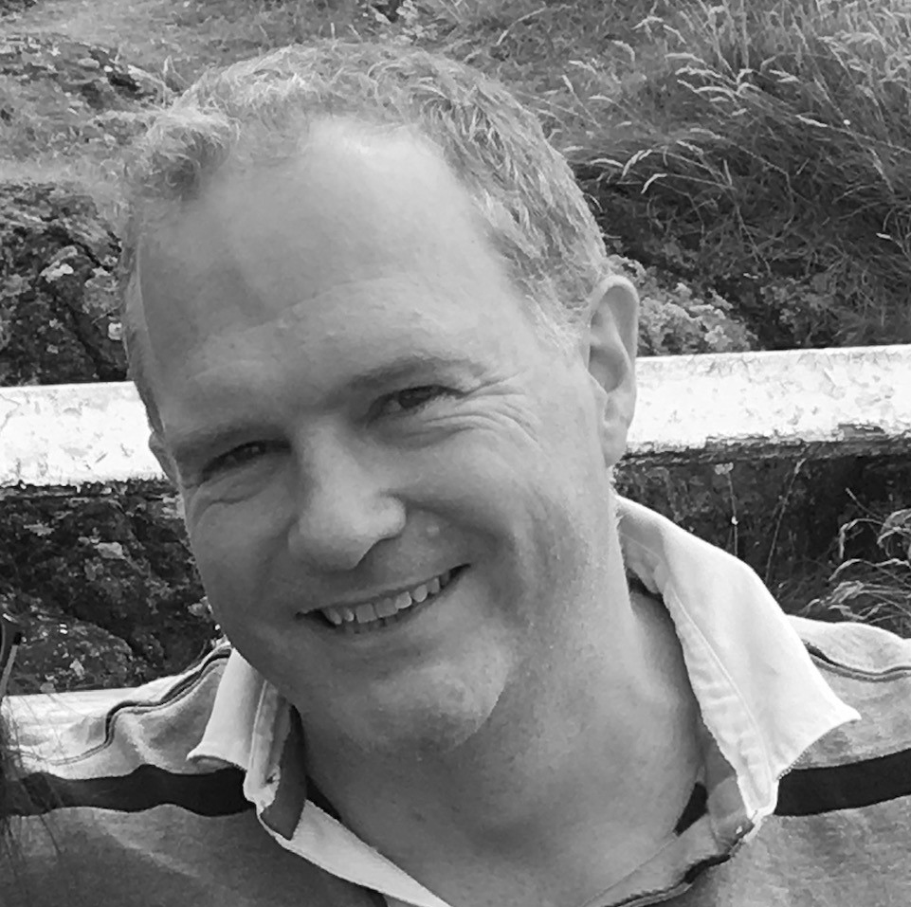
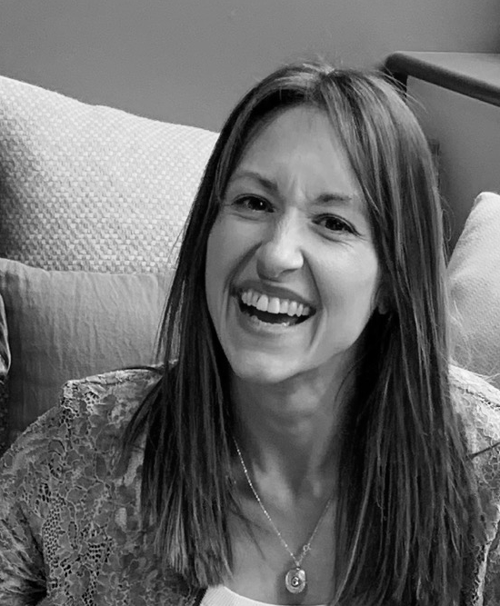
Introductions
Chris Lever
Consultant
Kirsty Cook
Global Director
Neuro-Inclusion Services

Slide 3
By the end of this session, you will:
Understand auticon and how we support our partners and ND communities.
Feel more confident talking about neurodivergence.
Have a better understanding of autism in particular.
See the value in universal accommodations.
Have useful strategies to work better with neurodivergent colleagues.

Slide 4
About auticon

Slide 5
auticon background
A social enterprise providing tech consulting in the fields of data analytics, cybersecurity and quality assurance and neuro-inclusion education, advice and support.
UK
France
Germany
Switzerland
Italy
USA
Canada
Australia
200
autistic employees on permanent contracts
Our decade of experiences hiring, training and creating neuro-inclusive work environment for ourselves and client teams is shared with our partners. We support other organisations in their commitment to having a neuro-inclusive workforce.
Founded in 2011 with a mission of to promote neurodiversity and improve the employment prospects of adults on the autism spectrum

Slide 6
Experience bullying, discrimination or harassment in the workplace.
Employers fear getting support and accommodations wrong.
71%
48%
60%
Increase in autism/aspergers related employment tribunals year-on-year.
Notes:
*All figures from National autistic society
EXCEPT
*Tribunals Research from employment law firm Fox & Partners

Slide 7
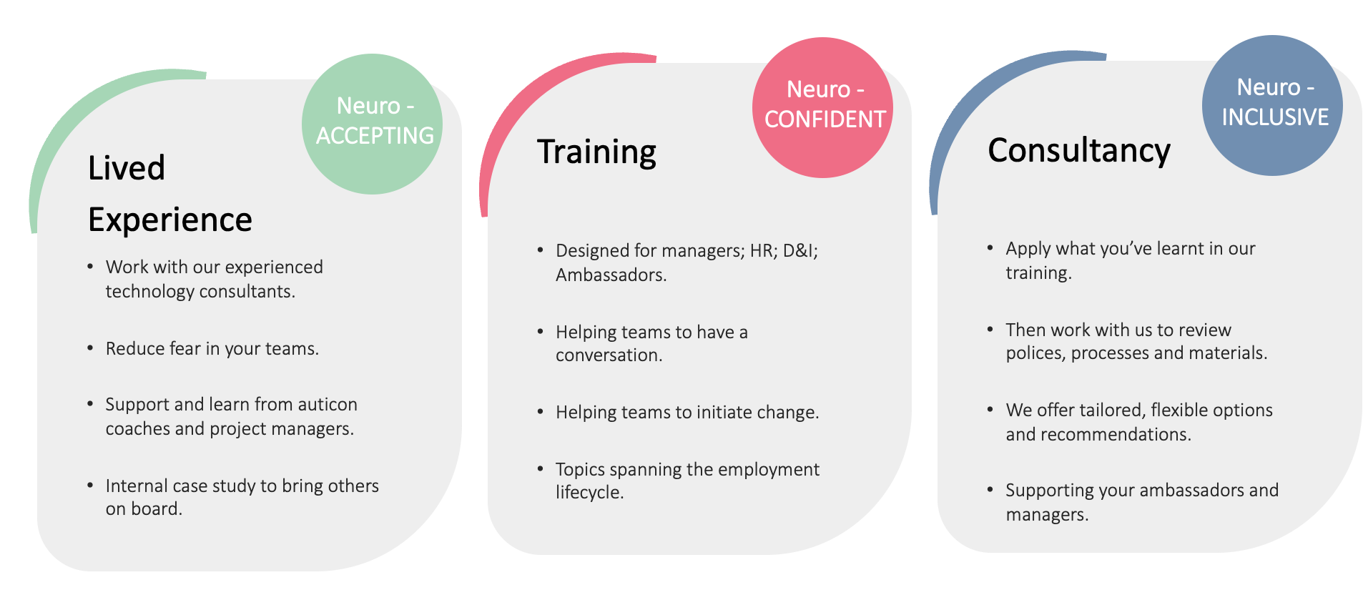
A path to Neuro-Inclusion
Notes:
.

Slide 8
Training Suite
Neurodiverse Team
Experience & Expertise
International Presence
Tailored for you
Buy Social
Purposeful Brand
Hidden autistic talent in your teams? Probably. Understand your autistic colleagues, their strengths and how you can work better together.
AWARENESS
MODULE 1
Neurodiversity and autism
in the workplace
MODULE 2
Neurodiversity and other Neurodivergent Conditions
FOUNDATION
FOUNDATION
ADVANCED
MODULE 3
Workplace Assessments
ADVANCED
MODULE 4
Disclosure
MODULE 5
Mental Health & Wellbeing
MODULE 6
Inclusive Communication
ADVANCED
ADVANCED
MODULE 7
Retention
MODULE 8
Onboarding
ADVANCED
ADVANCED
MODULE 9
Recruitment
MODULE 10
Workshop
Line Managers
ADVANCED
ADVANCED
Bespoke Workshops

Slide 9
What does it mean to have neurodiverse teams?

Slide 10
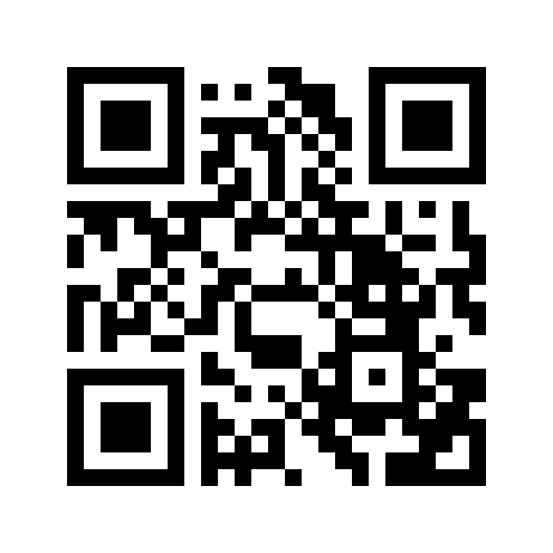
Joining Instructions
Join at vevox.app
Or search Vevox in the app store
ID: 168-021-589

Slide 11
That you know of, do you work in a neurodiverse team?
Join: vevox.app ID: 168-021-589

Slide 12
ADHD
Dyslexia
Autism
Dyspraxia
Each of these individuals are neurodivergent.
A NEURODIVERSE TEAM
No condition
Also known as
neurotypical (although we prefer not to use that word).
All neurodivergent, but not a
neurodiverse
group
Notes:
KEY

Slide 13
Autism, a neurodivergent condition

Slide 14
What do you think of when you hear the word autism?
Join: vevox.app ID: 168-021-589

Slide 15
Terminology
Social Anxiety
ADHD
Neurodifference
Hidden Disability
Neurodiversity
Condition
Burnout
Neuroprofile
Neurotypical
Autism
Neurodivergent
Person with Autism
Depression
ADD
Disability
Melt Down
Neurodivergence
Cognitive Overload
Combined Type
Dyslexia
Aspergers
PTSD
VAST
Autistic
Dyspraxia
General Anxiety
Disorder
Breakdown
Neurotype
Autistic person
Over Stimulation
Neurominority
Inattentive
Hidden Condition
Hyperactive
OCD
Sensory Overload
Anxiety

Slide 16
How would you rate your understanding of how to work well with autistic colleagues?
Join: vevox.app ID: 168-021-589

Slide 17
Social Communication & Interaction
Restricted Patterns & Behaviours
Sensory Processing
Intuitive communication is difficult.
Literal and direct language used.
Small talk hard, anxiety inducing.
Eye contact can be uncomfortable or even painful.
Structure & routine preferred.
Difficulty planning and prioritising.
Detailed and narrow topic focus.
Logical thinkers.
Hyper or hypo stimulation.
Difficulty filtering some input and so can’t process other useful information.
Sound, light, touch, spatial awareness,

Slide 18
Cognitive Differences
Autistic
Not Autistic
Above average ability
Trend Spotting
Creativity
Problem Solving
Quality
Accommodations for
support
Organisation
Focus
Priortisation
Sensory Processing

Slide 19
Creating a neuro-inclusive workplace

Slide 20
Remember…
Top Tips
Environment.
Equipment.
Executive functioning.
Information processing.
Social communication.
Workplace communication.
Digital communication (emails/Zoom/Teams).
Working practices (meetings/instructions/).
1
Individual before the label. Avoid assuming.
2
Universal accommodations.
3
Workplace assessments.
4
Listen, learn, support.

Slide 21
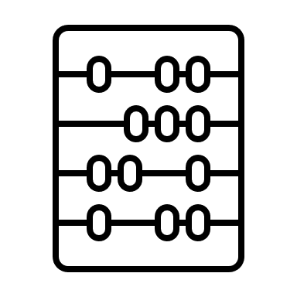
1). Strengths-based model for inclusion and support
FRANK
SEE THINGS DIFFERENTLY
PROBLEM
SOLVING
CREATIVITY
ANALYTICAL THINKING
PATTERN RECOGNITION
FACTUAL
MINDSET
ACCURACY
INNOVATIVE THINKING
TREND
SPOTTING
RETAINING
INFORMATION
QUALITY

Slide 22
2). Universal accommodations
Top Tips
Sensory
Executive functioning/
Information processing
Communication
Working practices
Equipment.
Preferred desk.
Break out space.
Meeting rooms.
Pomodoro technique.
Milestones.
Structure to instructions.
Extra processing time.
Advanced notice of change.
Deadline clarity.
Clear, direct, precise.
Preferred method.
Visual instructions.
Private, quiet space.
Avoid small talk.
Honest feedback.
Flexible hours.
Work from home day(s).
Staggered hours.
AM meetings vs. PM.

Slide 23
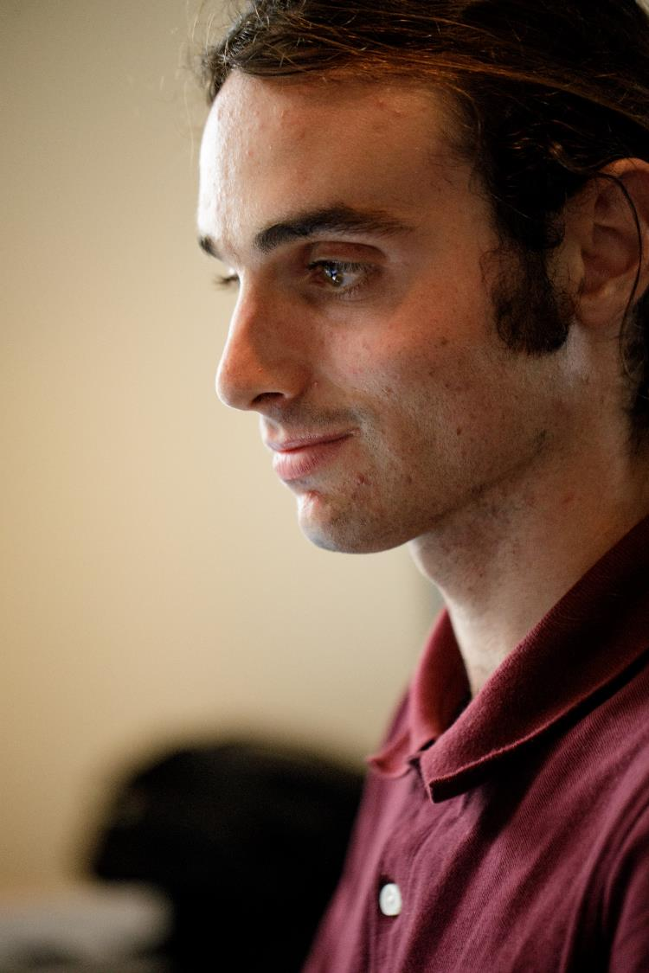
Thank you for listening
Discussion - Q&A
Kirsty Cook
Global Director DE&I Services
Kirsty.Cook@auticon.com
Autism: In conversation with auticon

Slide 24
Final Credits

Slide 25
Reasons to partner with us
Neurodiverse Team
Experience & Expertise
International Presence
Tailored for you
Buy Social
Purposeful Brand
Interactive training sessions approved and developed by neurodivergent colleagues. Training from neurodivergent trainers and experienced professionals.
Learn from a team of D&I experts with hundreds of years of combined experience in recruiting, supporting and employing neurodiverse talent.
Partner with a multi-cultural and multi-language organisation with operations in 9 countries and expanding globally.
Training includes your own examples and your colleagues valued input. Advisory services offer an approach and options that suits your business, your team and your neurodiverse colleagues.
Procure professional services from a supplier with 80% of its workforce in the autism spectrum, and where revenues are reinvested towards impact.
Partner with an award-winning social enterprise with a strong social mission of equity and inclusion.

